Slide 2
PART I
BY THE WATERS
OF BABlYON

Slide 3
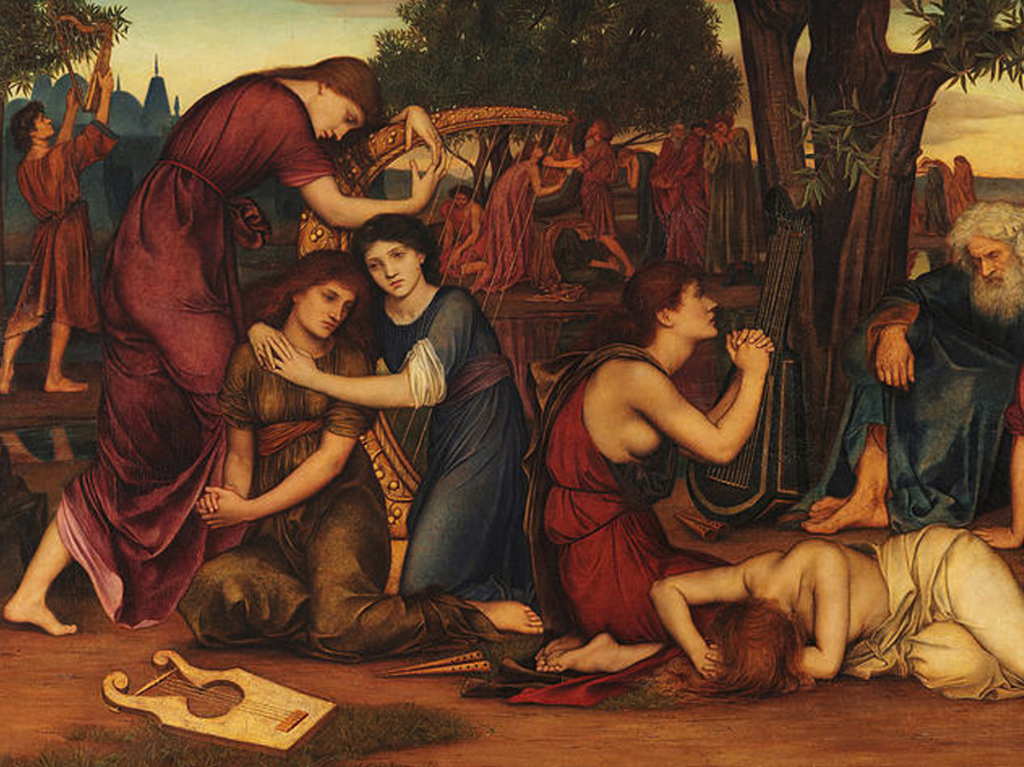

Slide 4
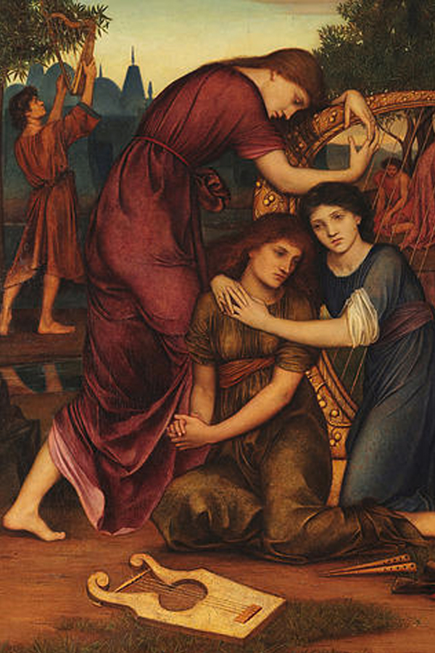
CHORUS OF
JEWISH WOMEN
By the waters of Babylon we sat
down and wept ;
When we remembered thee,
O Sion.

Slide 5
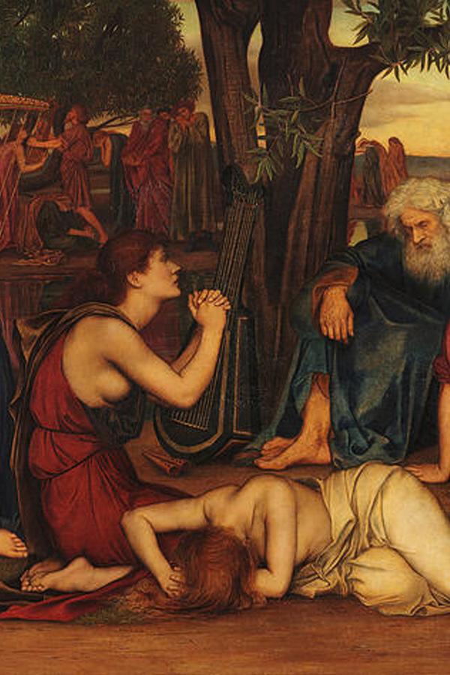
CHORUS OF
JEWISH WOMEN
As for our harps we hanged them up ; upon the trees that are therein.

Slide 6
CHORUS OF
JEWISH WOMEN
For they that led
us away captive required of us then
a song, and melody, in our heaviness.

Slide 7
CHORUS OF
assyrians &
JEWISH WOMEN
Sing us one of the songs of Sion.
How shall we sing the Lord’s song
in a strange land ?

Slide 8
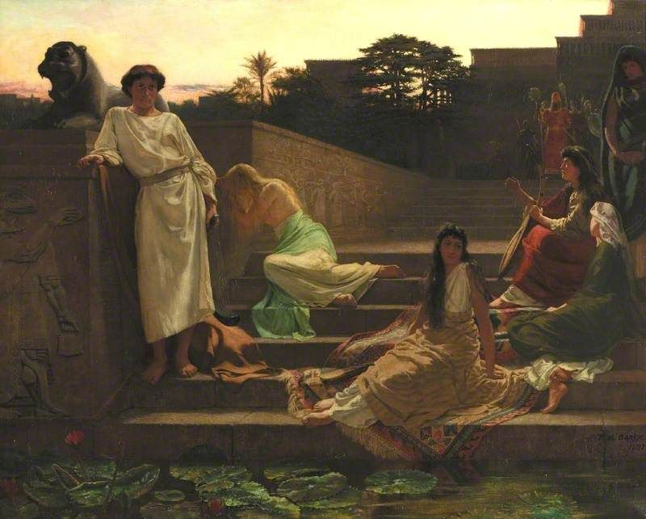
Soprano solo & CHORUS OF JEWISH WOMEN
If I forget thee,
O Jerusalem, let my right hand forget her cunning.

Slide 9
Soprano solo
& CHORUS OF JEWISH WOMEN
If I do not remember thee, let my tongue cleave to the roof of my mouth ; yea, if I prefer not Jerusalem in the day of my mirth.

Slide 10
Soprano solo
& CHORUS OF JEWISH WOMEN
O God, the heathen have come into Thine inheritance ;
Thy holy temple have they defiled, and made Jerusalem an heap of stones.

Slide 11
Chorus of Assyrian warriors
Down with them !
Come, let us make havock of them altogether.

Slide 12
Chorus of Assyrian warriors
Let us burn up the houses of God in the land.
Down with them, down with them, even unto the ground.

Slide 13
Soprano solo &
Chorus Of jewish women
O daughter of Babylon, wasted with misery ;
yea, happy shall he be that rewardeth thee as thou hast served us.

Slide 14
Soprano solo &
Chorus Of jewish women
Blessed shall he be that seeketh revenge on Babylon.
By the waters of Babylon, we sat down and wept ; when we remembered thee, O Sion.

Slide 15
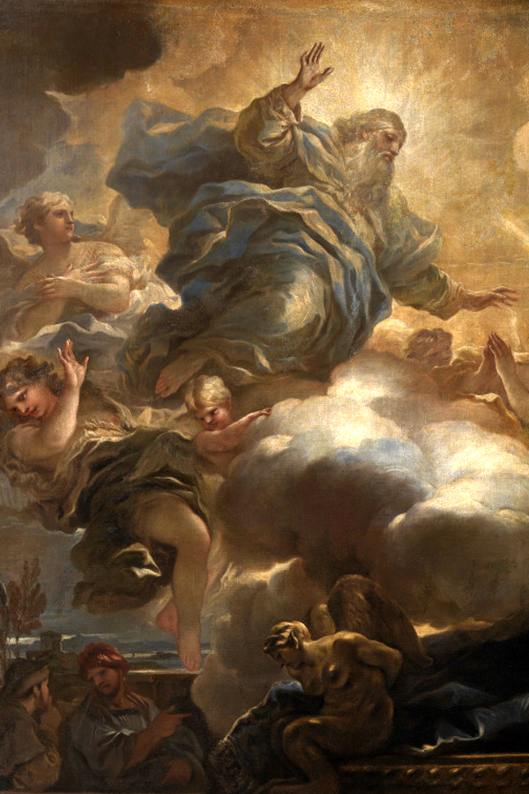
chorus
The heathen shall fear Thy name, O Lord,
And all the kings of the earth Thy Majesty !
When the Lord shall build up Sion, and when His glory shall appear.

Slide 16
chorus
O Jerusalem, look about thee towards the east,
And behold the joy that cometh unto thee from God.

Slide 17
chorus
For lo ! Thy sons come, whom thou sentest away ;
They come gathered together from the east to the west by the word of the Holy One, rejoicing in the glory of God.

Slide 18
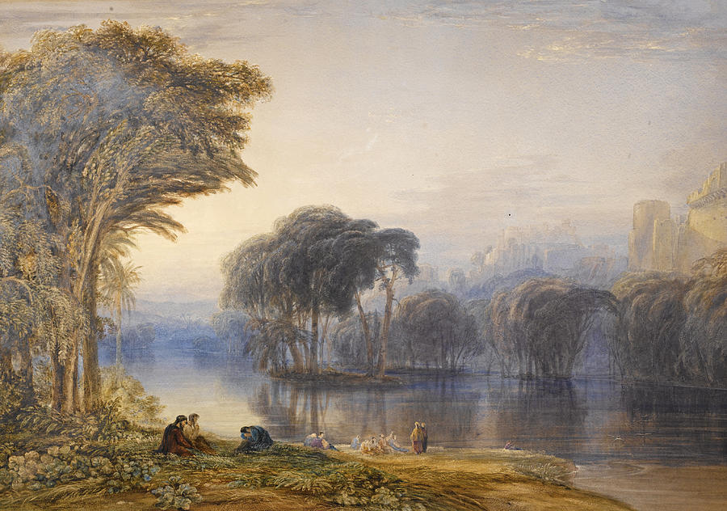
INTERMISSION

Slide 19
PART Ii
On the plain
Of dura

Slide 20
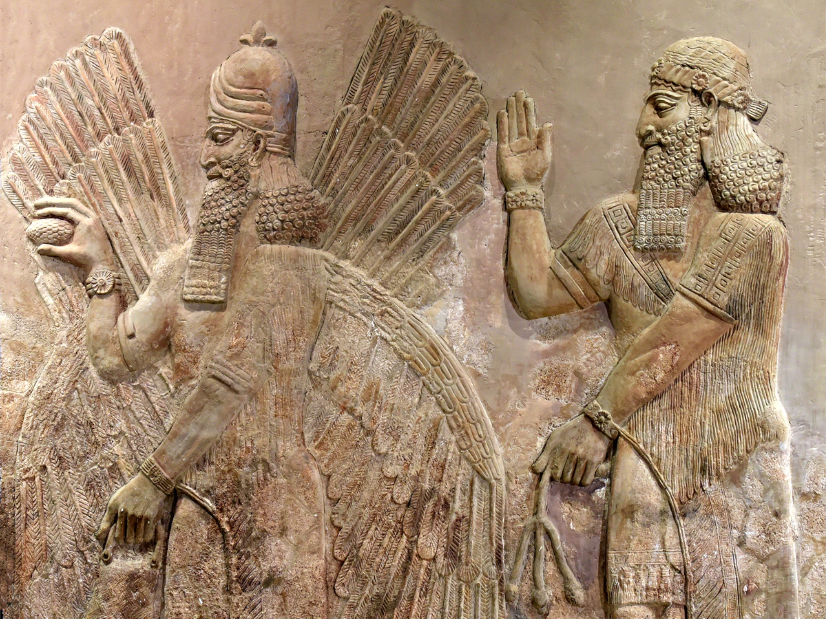

Slide 21
Chorus of assyrians
Bel ! Great is thy name, among all gods most honoured thou.
With fuller hand thou givest back the gifts we bring to thee.

Slide 22
Chorus of assyrians
Kingship be thine over gods and men, High thy command, unconquered thy sword, tremble thy foes over all the earth !

Slide 23
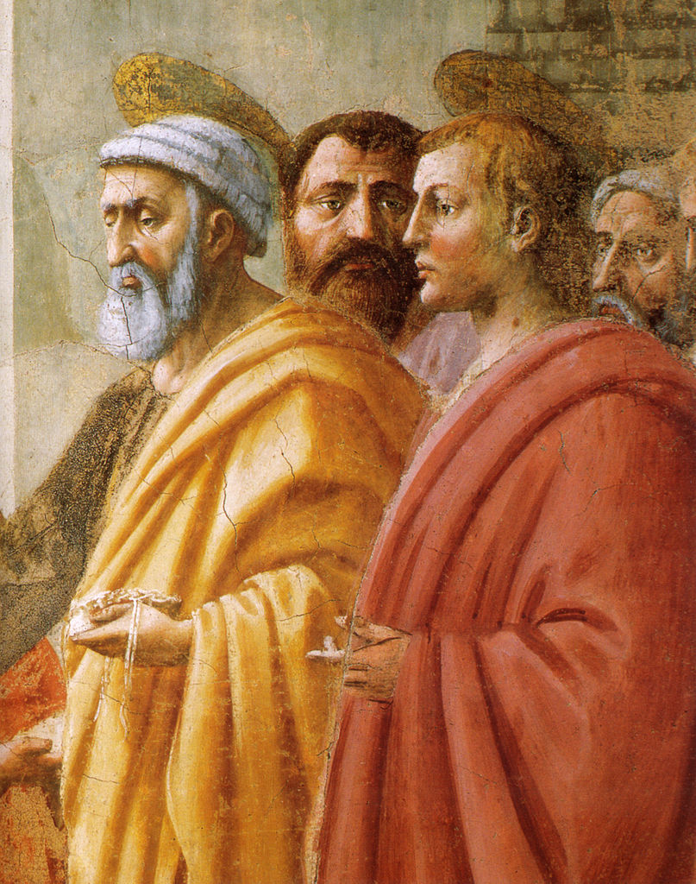
The three holy children
As for the images of the heathen, they are but silver and gold : even
of men’s hands.
They have mouths, and speak not ; eyes have they,
but they see not.

Slide 24
The three holy children
They have ears, and yet they hear not ; neither is there any breath in their mouths.
They that make them are like unto them ; and so are all they that put their trust in them.

Slide 25
Chorus of assyrians
Bel ! Great is thy name ! Kingship be thine over gods and men !
O King, live forever.
Thy greatness is grown, and reacheth
Unto heaven, and thy dominion to the
end of the earth.

Slide 26
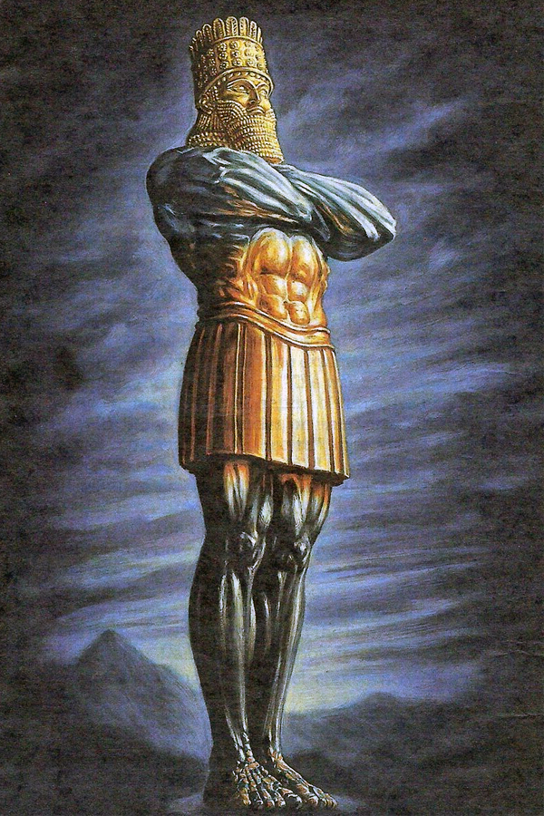
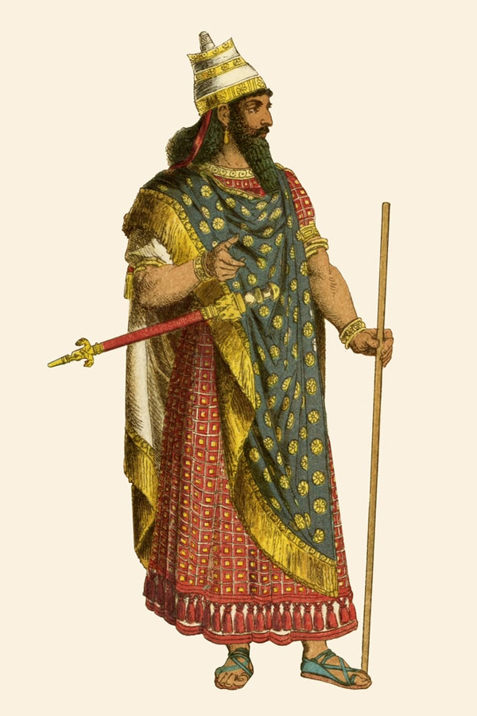
The herald
To you it is commanded,
O people, nations, and languages, that at what time ye hear the sound of musick, ye fall down and worship the golden image that the King hath set up.

Slide 27
The herald
And whoso falleth not down and worshippeth, shall be cast into the midst of a burning fiery furnace !

Slide 28
Chorus of assyrians
O King, live for ever :
Thy greatness is grown and reacheth unto heaven, and thy dominion to the ends of the earth.

Slide 30
Assyrian nobles
O king, live for ever.
There are certain Jews whom thou set over Babylon – Ananias, Azarias and Misael ;

Slide 31
Assyrian nobles
These men, O king, have not regarded thee ; they serve not thy gods, nor worship the golden image which thou hast set up.

Slide 32
King nebuchadnezzar
Is it true ? Do ye not serve my gods, nor worship the golden image which I have set up ?

Slide 33
King nebuchadnezzar
Now if ye fall down and worship, well ; but if ye worship not, ye shall be cast the same hour into the midst of a burning fiery furnace ; and who is that God that shall deliver you out of my hand.

Slide 34
The three holy children
Our God whom we serve is able to deliver us from the burning fiery furnace, and He will deliver us out of thine hand, O king.

Slide 35
The three holy children
But if not, be it known unto thee, O king, we will not serve thy gods, nor worship the golden image which thou hast set up.

Slide 36
chorus
Then was the King full of fury, and the form of his visage was changed against the men ;

Slide 37
chorus
chorus
Therefore he spake, and commanded that they should heat the furnace seven times more than it was wont to be heated.

Slide 38
chorus
And he commanded the most mighty men that were in his army to bind and cast them into the furnace.

Slide 39
chorus
Then these three men were bound, and cast into the midst of the burning fiery furnace.

Slide 40
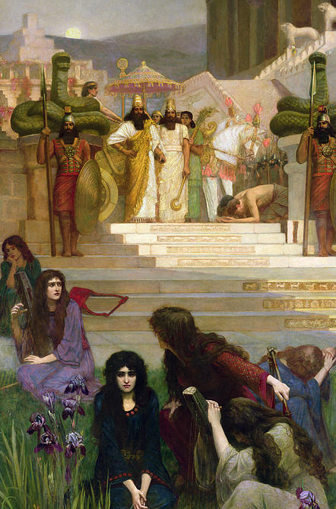
Chorus of
jewish women
O daughter of Babylon, wasted with misery ; yea, happy shall he be that rewardeth thee as thou hast served us.

Slide 41
azarias
Blessed art Thou,
O Lord God of our fathers ;
Thy name is worthy to be praised and glorified for evermore ; For Thou art righteous in all the things that Thou hast done to us :

Slide 42
azarias
Yea, true are all Thy works, Thy ways are right, and all Thy judgments truth.
For we have sinned and committed iniquity, departing from Thee.

Slide 43
azarias
In all things have we trespassed, and not obeyed Thy commandments, nor kept them,
Neither done as Thou hast commanded us, that it might go well with us.

Slide 44
azarias
And now we cannot open our mouths, we are become a shame and reproach to Thy servants, and to them that worship Thee.

Slide 45
azarias
Yet deliver us not up wholly, for Thy Name’s sake, neither disannul Thou Thy covenant:

Slide 46
azarias
And cause not Thy mercy to depart from us, but in a contrite heart and humble spirit let us be accepted.

Slide 47
azarias
And now we follow Thee with all our heart ;
We fear Thee, and seek Thy face.
Put us not to shame :

Slide 48
azarias
But deal with us after Thy loving-kindness, and according to the multitude of Thy mercies.
Deliver us also according to Thy marvellous works,

Slide 49
azarias
And let all them that do Thy servants hurt be ashamed ;
And confounded in all their power and might, and let their strength be broken ;

Slide 50
The three holy children
And let them know that Thou art Lord, the only God, and glorious over the whole world.

Slide 51
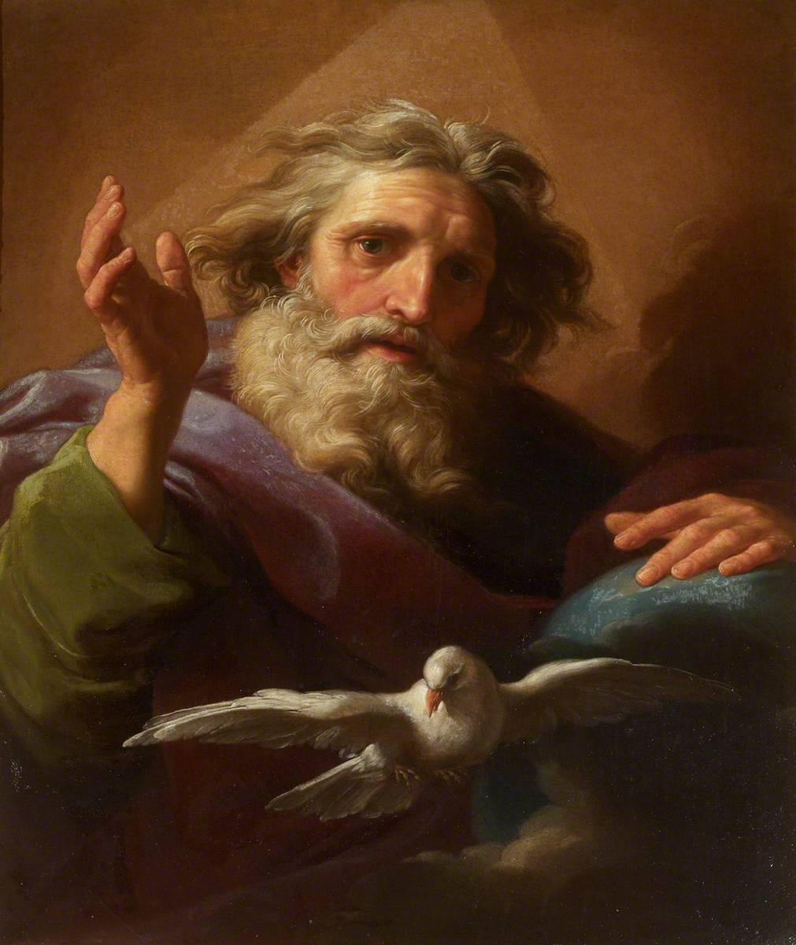
Soprano solo
& chorus
Ye are My witnesses and My servants whom I have chosen ;
That ye may know and believe Me, and understand that I am He.

Slide 52
Soprano solo
& chorus
Before Me there was no God formed, neither shall be after Me.
I, even I, am the Lord ; and beside Me there is no Saviour.

Slide 53
chorus
And the King’s servants that cast them in ceased not to make the furnace hot with rosin, and pitch, and tow and wood ;

Slide 54
chorus
So that the flame streamed forth high above the furnace ;
And it passed through and slew those whom it found about the furnace.

Slide 55
Soprano
solo
But the angel of the Lord came down into the furnace, and smote the flame of the fire out of the furnace ;

Slide 56
Soprano
solo
And made the midst of the furnace as it had been a moist whistling wind, so that the fire touched them not at all, neither hurt nor troubled them.

Slide 57
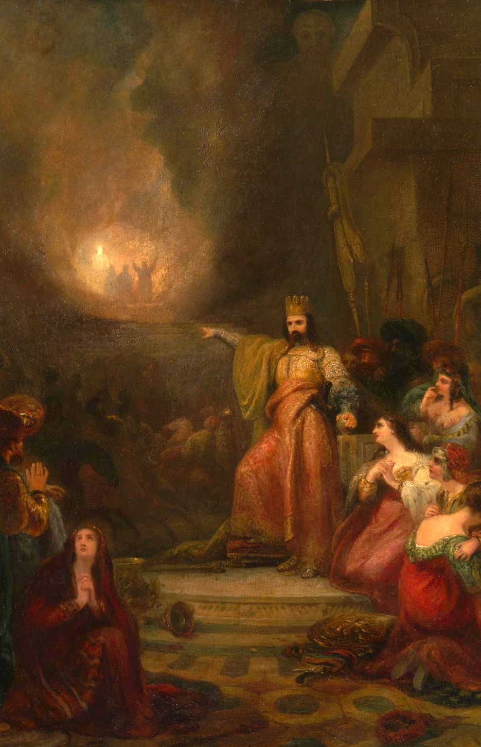
The King
& Chorus
Did we not cast three men bound into the midst of the fire ?
True, O King !

Slide 58
The King
& Chorus
Lo ! I see four men loose, walking in the midst of the fire, and they have no hurt ; and the form of the fourth is like the Son of God.

Slide 59
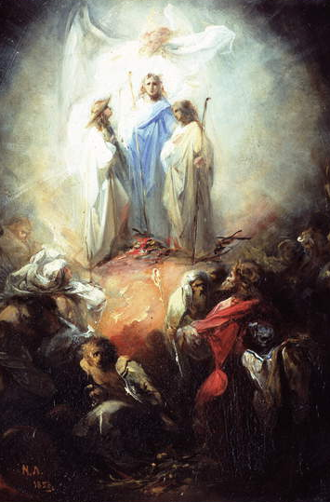
Three holy children
Blessed art thou O Lord God of our fathers, and to be praised and exalted above all for ever.

Slide 60
Three holy children
And blessed is Thy glorious and holy name, and to be praised and exalted above all for ever.

Slide 61
Three holy children
Blessed art Thou, in the Temple of Thy holy glory, and to be praised and exalted above all for ever.

Slide 62
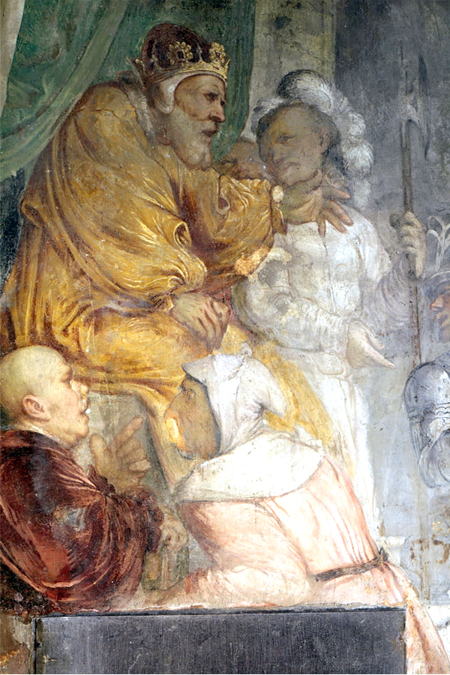
The king & Chorus
Ye servants of the Most High God, come forth and come hither.
Blessed be your God, who has sent His Angel, and delivered His servants that trusted in Him.

Slide 63
The king & Chorus
There is no other God that can deliver after this sort.

Slide 65
O all ye works of the Lord, bless ye the Lord, praise Him above all for ever.
O ye heavens, bless ye the Lord, praise and exalt Him above all for ever.
O ye angels of the Lord, bless ye the Lord, praise and exalt Him above all for ever.

Slide 66
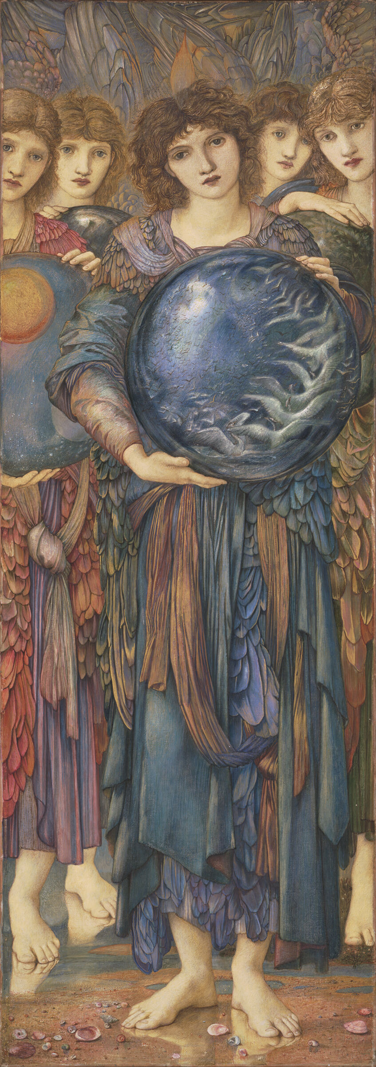
O ye waters above the heavens, bless ye the Lord, praise and exalt Him above all for ever.
O ye powers of the Lord, bless ye the Lord, praise and exalt Him above all for ever.
O ye sun and moon, bless ye the Lord, praise and exalt Him above all for ever.

Slide 67
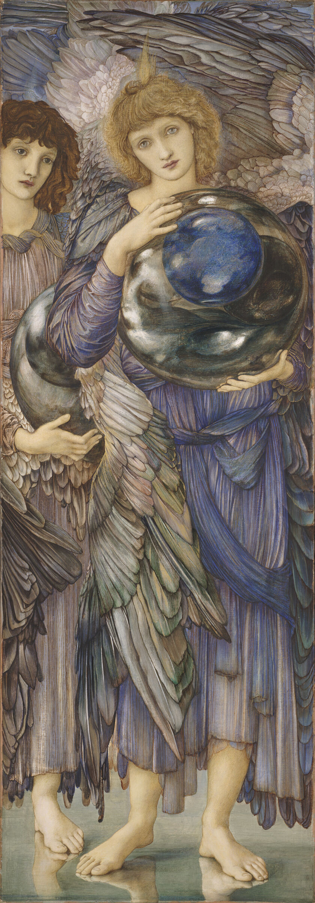
O ye stars of heaven, bless ye the Lord, praise and exalt Him above all for ever.
O ye showers and dew, bless ye the Lord, praise and exalt Him above all for ever.
O ye winds of God, bless ye the Lord, praise and exalt Him above all for ever.

Slide 68
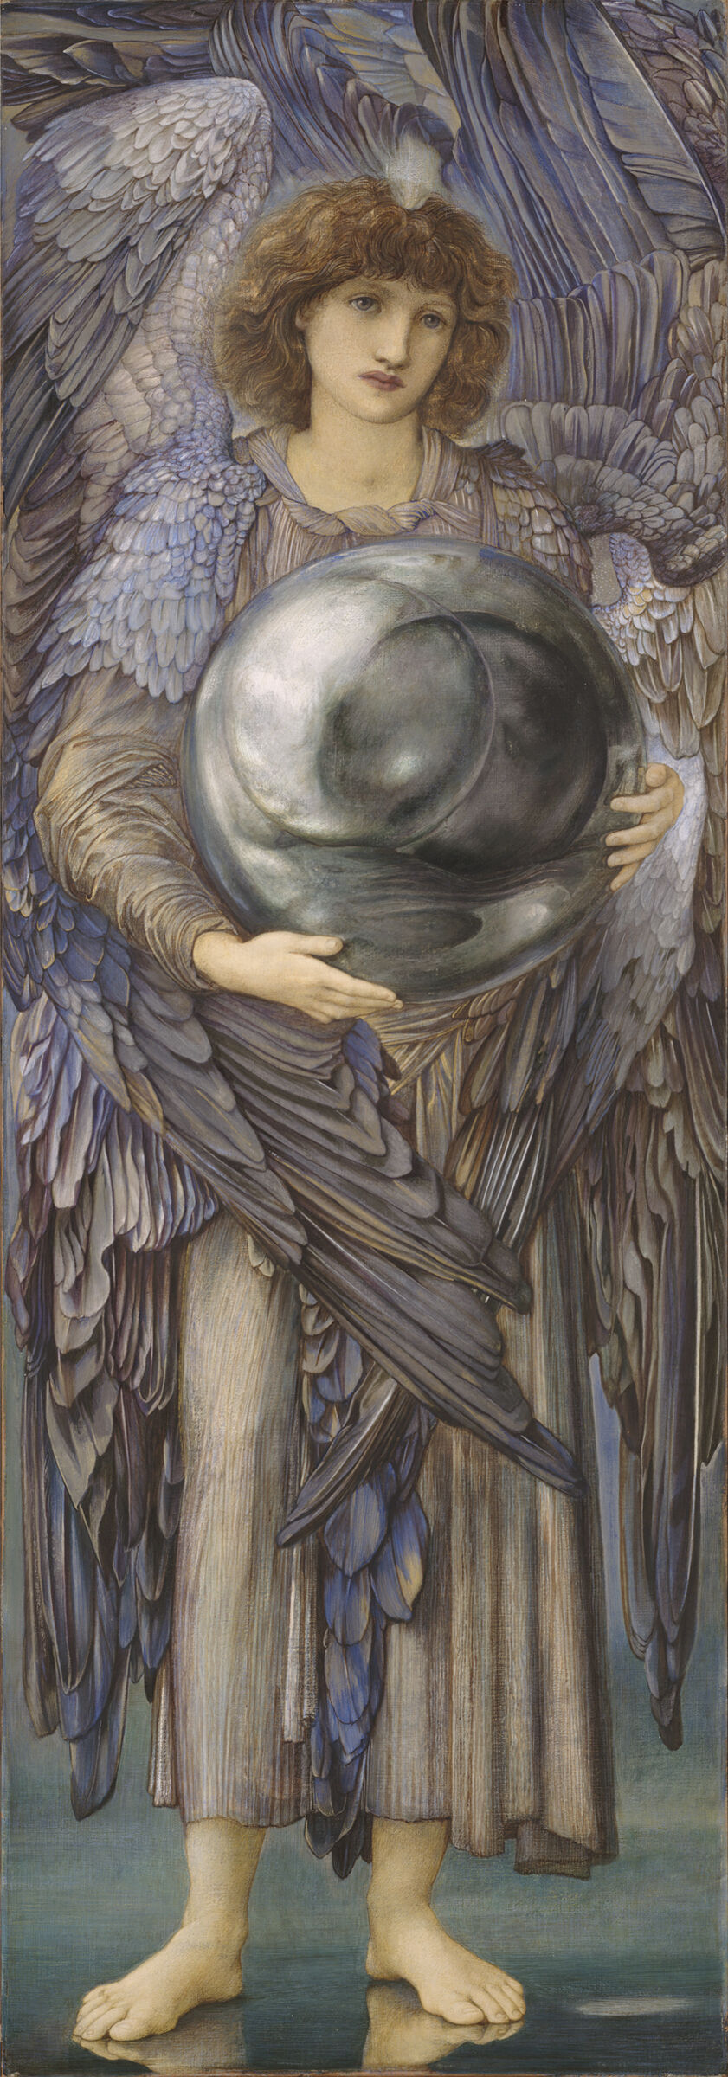
Praise the Lord upon earth ; ye dragons and all deeps ;
Fire and hail, snow and vapour ; wind and storm fulfilling His word.
O ye mountains and all hills ; fruitful trees and all cedars;

Slide 69
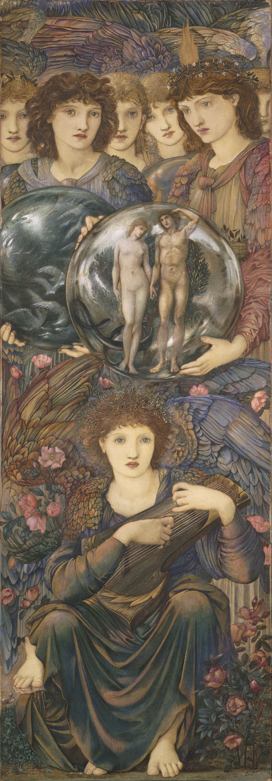
O ye fowls of the air, bless ye the Lord, praise and exalt Him above all for ever.
O ye beasts and cattle, bless ye the Lord, praise and exalt Him above all for ever.
O ye children of men, bless ye the Lord, praise and exalt Him above all for ever.

Slide 70
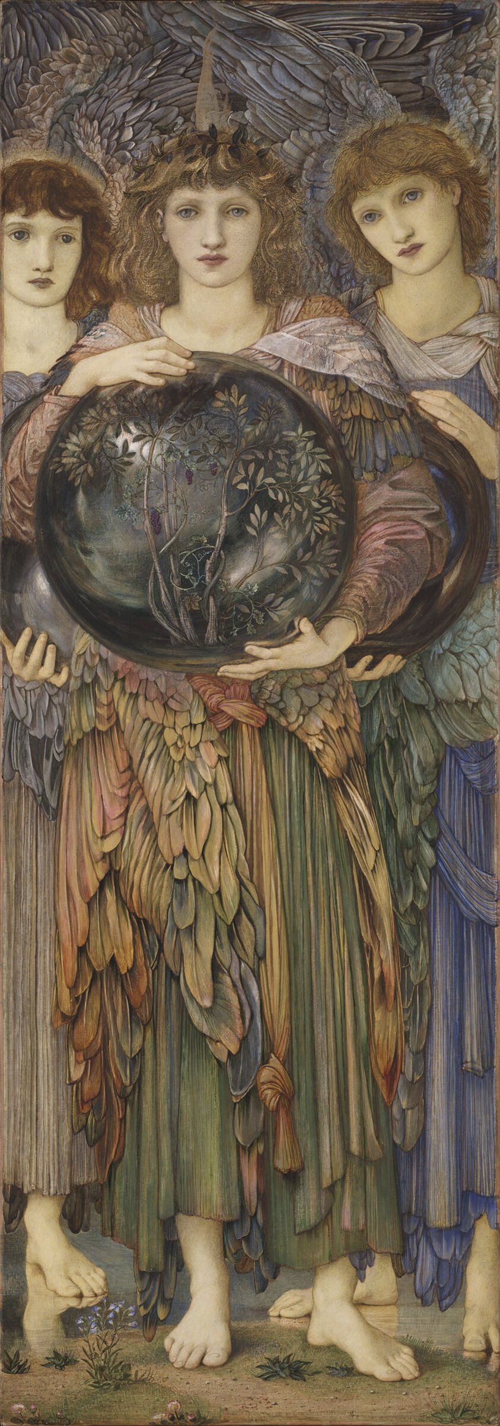
O ye priests of the Lord, bless ye the Lord praise and exalt Him above all for ever.
All that worship the Lord, bless ye the Lord, praise and exalt Him above all for ever.
For His Name only is excellent, and His praise above heaven and earth.

Slide 71
Hallelujah !

